Slide 1
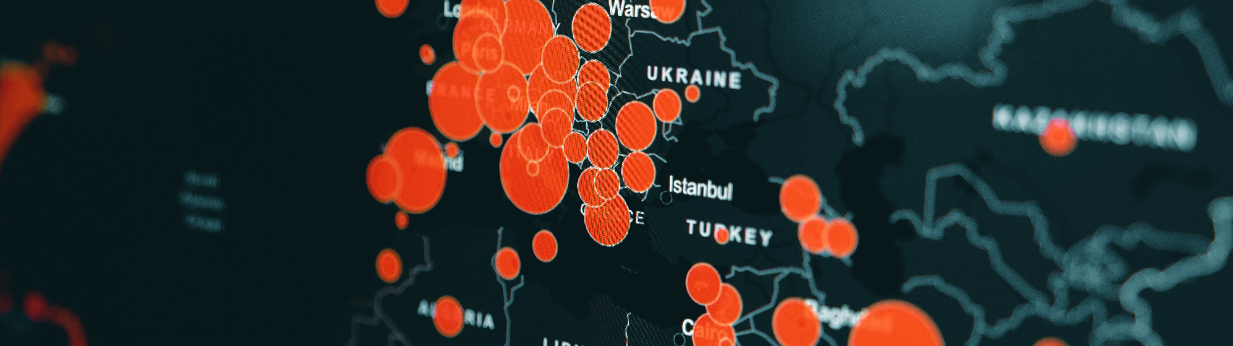

Data Analysis Report for Fond Rouge
MIHIR ,
Technical consultant intern , SAP USA
JULY , 2023

Slide 2
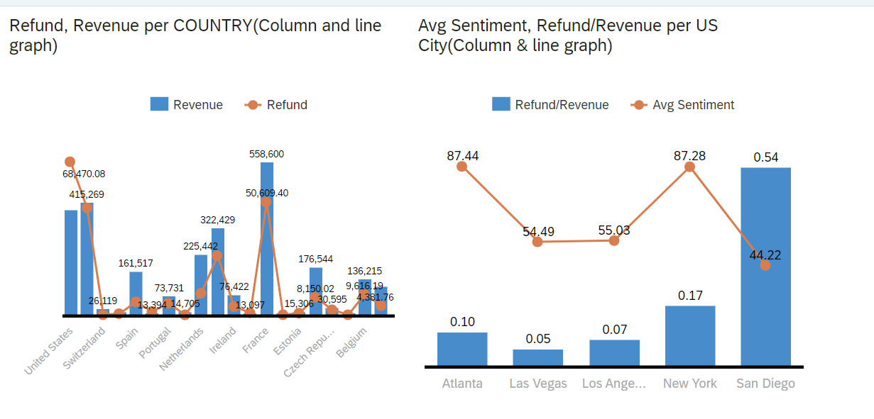
Data Analysis Report for Fond Rouge

Slide 3
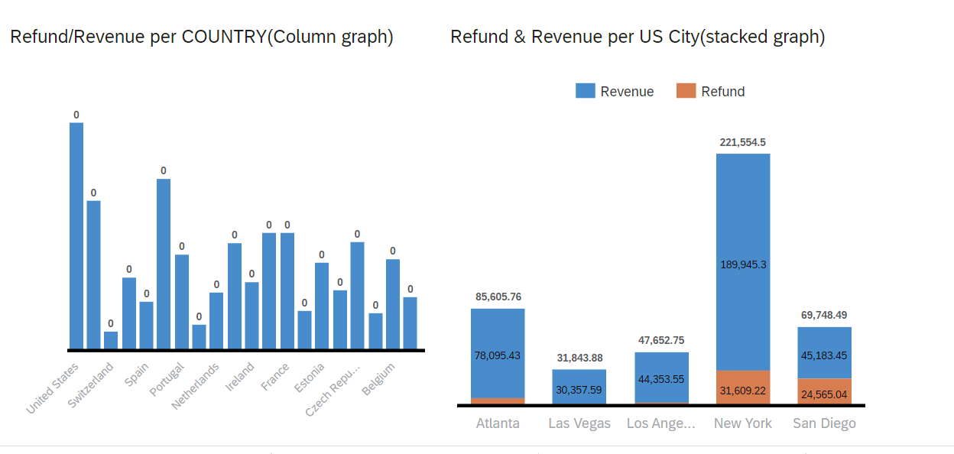
Data Analysis Report for Fond Rouge
.

Slide 4
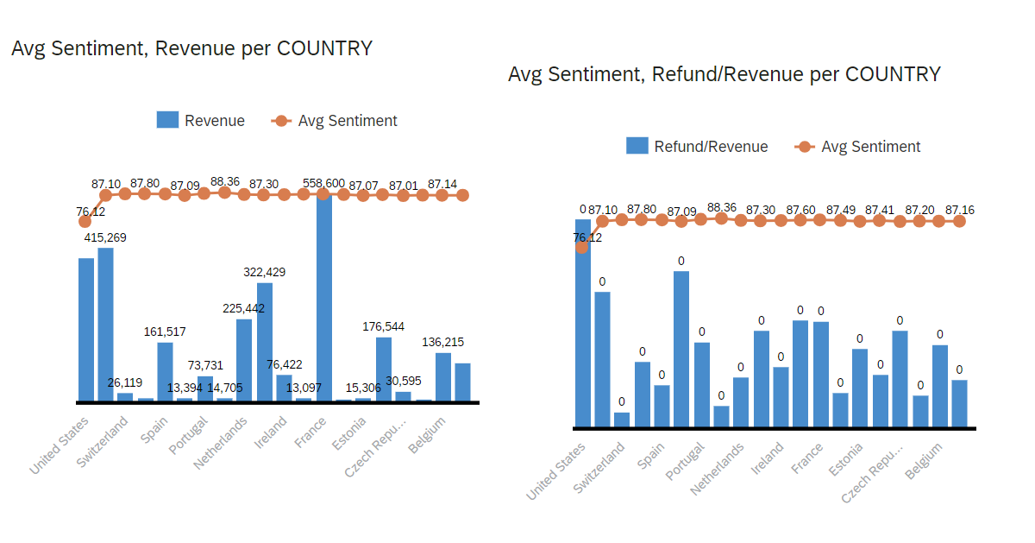
Data Analysis Report for Fond Rouge

Slide 5

Data Analysis Report for Fond Rouge COMPARISON AMONG COUNTRIES – 1) In USA , Refund is more than revenue. 2) In SWITZERLAND , Refund is almost equal to revenue. 3) In SPAIN, PORTUGAL, NEITHERLAND, IRELAND AND FRANCE , considerable amount of refund is also observed. 4) Avg Sentiment of people is less in USA while in other countries it is at peak. 5) Refund percentage is highest in USA as compared to other countries.

Slide 6
Data Analysis Report for Fond Rouge
Analysis in USA
SAN DIEGO – Refund percentage is highest and avg. sentiment of the people is moderate. It indicates the presence of large amount of counterfeit product in san diego.
ATLANTA & NEW YORK – Refund percentage is moderate and avg. sentiment of the people is high. It indicates the presence of moderate amount of counterfeit products.
LAS VEGAS & LOS ANGELES – Refund percentage is minimum and avg. sentiment of the people is moderate. It indicates that may be some amount of counterfeit products are present.

Slide 7
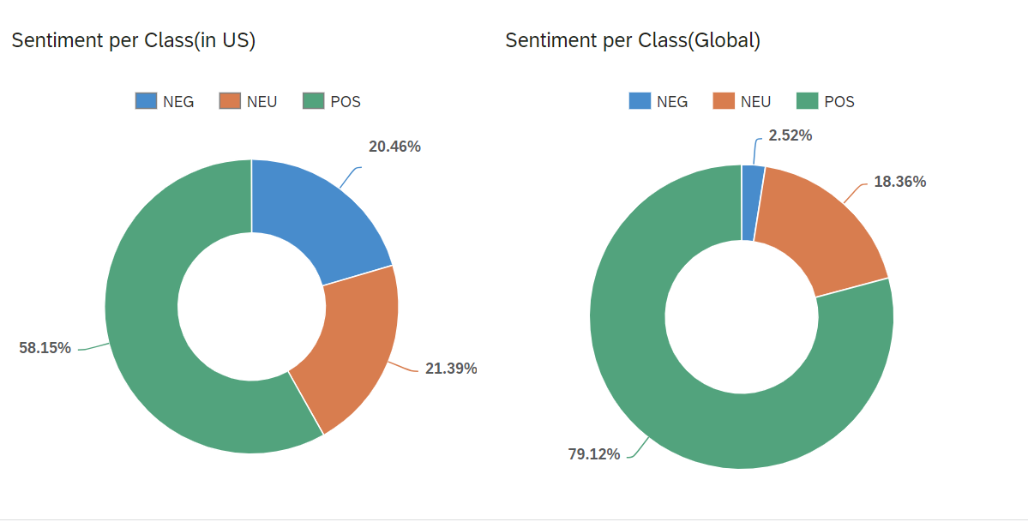
Data Analysis Report for Fond Rouge
1) ~ 3% people in the world have negative sentiment for Fond’s product . It indicates that Fond is known for producing good quality products in the world.
2) In USA itself , ~21% people have negative sentiments regarding Fond’s product . It indicates the involvement of some counterfeit products in USA market of Fond.
So, Counterfeit is the major observed issue in USA .

Slide 8
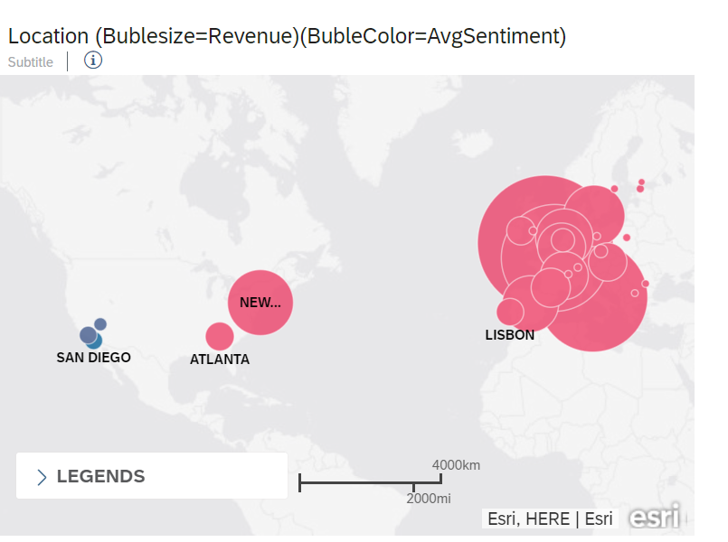
Data Analysis Report for Fond Rouge

Slide 9
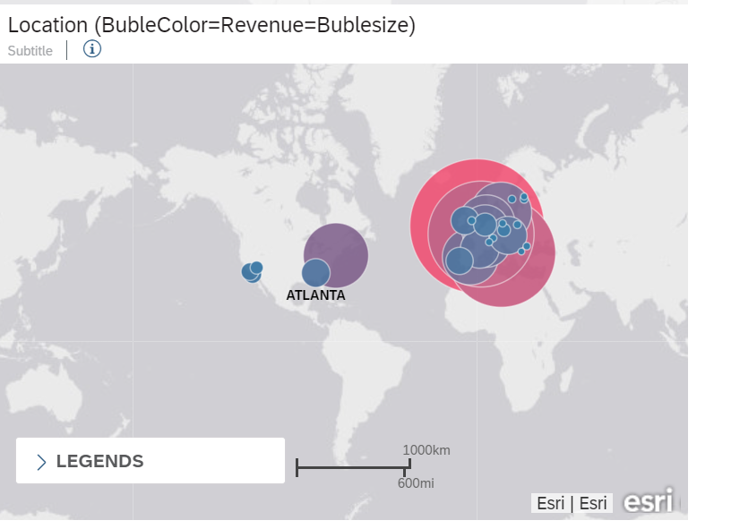
Data Analysis Report for Fond Rouge

Slide 10
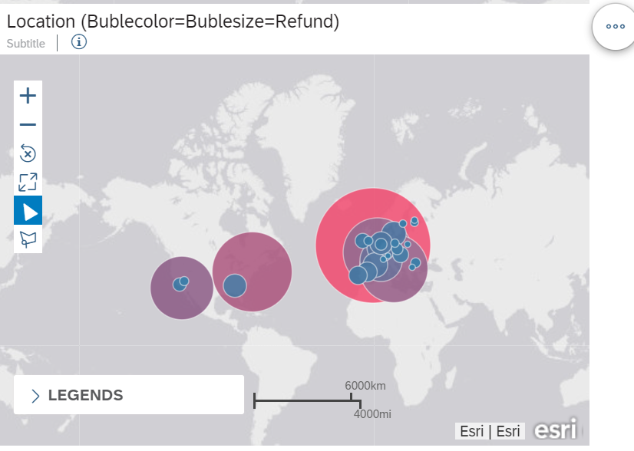
Data Analysis Report for Fond Rouge

Slide 11
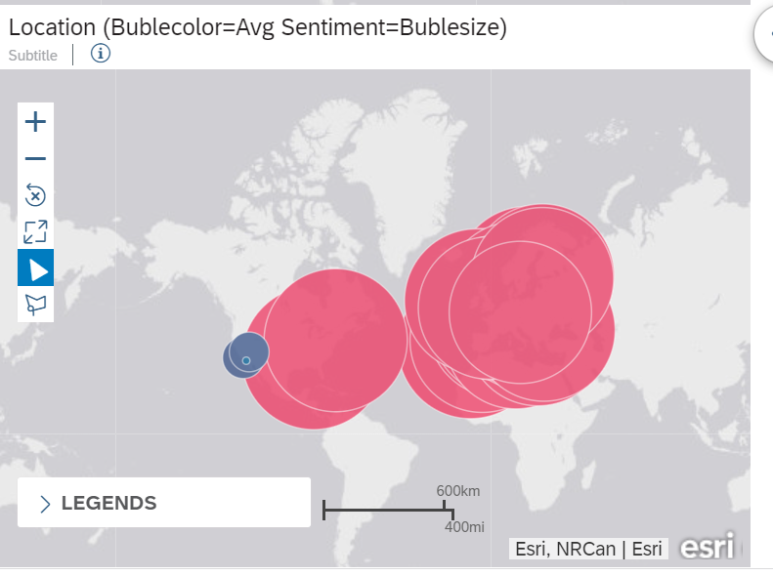
Data Analysis Report for Fond Rouge

Slide 12
Data Analysis Report for Fond Rouge
WAYS TO NARROW DOWN THE AFFECTED LOCATION
1)Investigate Supply Chain: Examine your supply chain thoroughly to identify potential entry points for counterfeit products. Conduct audits of suppliers, distributors, and retailers to ensure authenticity and quality control.
2)Collaborate with Customers: Reach out to customers who have left negative reviews to understand their experiences and identify potential counterfeit products. This can help in pinpointing specific locations or distribution channels where counterfeit items are circulating.

Slide 13
Data Analysis Report for Fond Rouge
WAYS TO NARROW DOWN THE AFFECTED LOCATION
3)Monitor Social Media and Forums: Actively monitor social media platforms, online forums, and consumer discussion groups where customers may discuss counterfeit products. Engage with customers to gather more information and respond to their concerns.
4)Work with Online Marketplaces: Collaborate with major online marketplaces where Fond Rouge's products are sold. Share your concerns about counterfeits and explore ways to improve product verification processes. Many platforms have measures in place to combat counterfeit goods, and they may be able to assist in the removal of counterfeit listings.

Slide 14
Data Analysis Report for Fond Rouge
WAYS TO NARROW DOWN THE AFFECTED LOCATION
5)Investigate Supply Chain: Examine your supply chain thoroughly to identify potential entry points for counterfeit products. Conduct audits of suppliers, distributors, and retailers to ensure authenticity and quality control.
6)Implement Anti-Counterfeit Measures: Develop and implement measures to distinguish genuine Fond Rouge products from counterfeit ones. These may include unique packaging, holographic labels, QR codes, or serial numbers that customers can verify on the company's website.
7)Educate Customers: Launch a consumer education campaign to raise awareness about the issue of counterfeits. Provide information on how customers can identify genuine products and report suspected counterfeit items.

Slide 15
Data Analysis Report for Fond Rouge WAYS TO NARROW DOWN THE AFFECTED LOCATION 8)Strengthen Legal Protections: Consult with legal experts to ensure that Fond Rouge's intellectual property rights are protected. Consider taking legal action against counterfeiters, if necessary, to deter further infringement. 9)Collaborate with Law Enforcement: If counterfeiting is a widespread and serious problem, involve law enforcement agencies to investigate and dismantle counterfeiting operations. 10)Improve Communication: Keep customers informed about the company's efforts to combat counterfeits. Transparency in addressing the issue can help build trust with consumers.

Slide 16
Data Analysis Report for Fond Rouge WAYS TO NARROW DOWN THE AFFECTED LOCATION 11)Continuous Monitoring and Adaptation: Counterfeiters may change tactics, so it's essential to continuously monitor the market and adapt strategies accordingly.

Slide 17
Data Analysis Report for Fond Rouge WAYS TO NARROW DOWN THE AFFECTED LOCATION “Success will require a multi-pronged approach involving collaboration with various stakeholders and constant vigilance. By taking these steps, Fond Rouge can safeguard its reputation, protect customers from inferior products, and maintain a strong market position”.

Slide 18

Thank you.
Contact information:
MIHIR
Technical consultant intern,
SAP USA
E-mail : career.mihir26@gmail.com

